Slide 1
Hand Gesture Recognition
Mini Project 2019

Slide 2
The Team
Maulik Shah
Parth N. Shah
Raj B. Shah

Slide 3
Introduction

Slide 4
The Problem
To develop a system which:
Takes an image-based input of hand gesture symbols
Recognizes the gesture
Classifies the image according to previously learned gestures
Provides a plain-text output of the gesture type.

Slide 5
The Challenges
Robustness
Robustness
Self Occlusion
Computation Time
The algorithm must be robust enough to adapt to varying illumination changes and shadow artefacts.
Hand Gestures often occlude (obstruct) themselves.
The classifier should be able to classify the gesture fast.
Notes:
Self Occlusion: Hand often obstructs itself ..so results in less data points for the classifier.
Computation time: 2 applications ..sign language and air gestures..

Slide 6
Literature Review

Slide 7
Studied Approaches
The approaches proposed in various papers are:
Convolutional Neural Networks.
Hand Gesture Recognition using Finger Segmentation.
Hand Gesture Recognition using Random Forest and LDA.

Slide 8
Proposed System

Slide 9
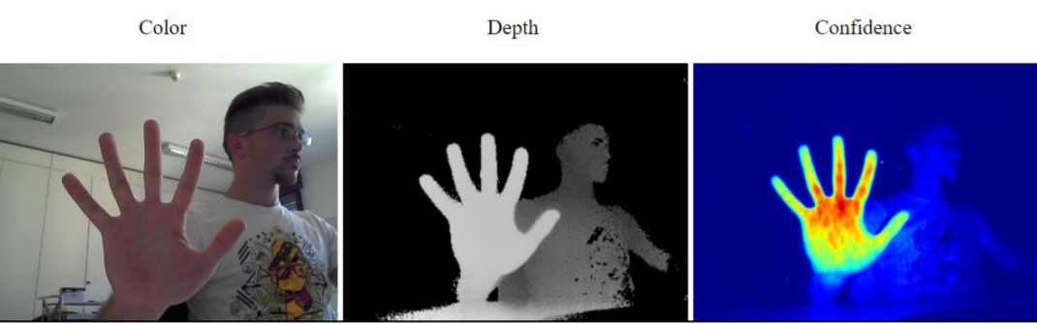
Scope of the Project
Our scope is limited to detecting and classifying 11 gestures only.
Results will be based on images from the Creative Senz3D camera only.

Slide 10
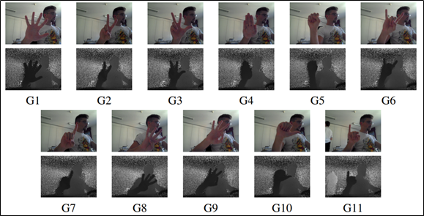
Dataset Used
We have used the Senz3D dataset which contains gestures performed by 4 different people, each performing 11 different gestures repeated 30 times each, for a total of 1320 samples.
For each sample, colour, depth and confidence frames are available.

Slide 11
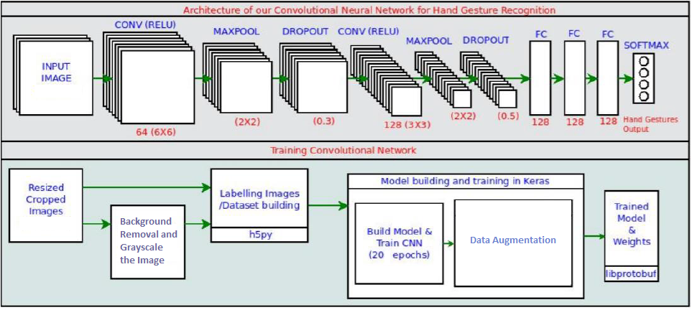
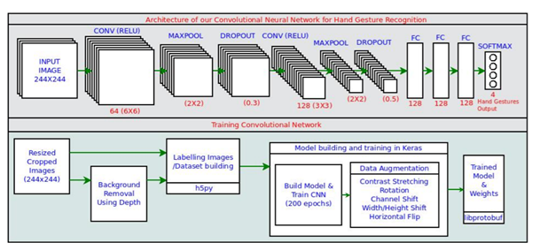
Architecture of the Proposed System

Slide 12
Implementation

Slide 13
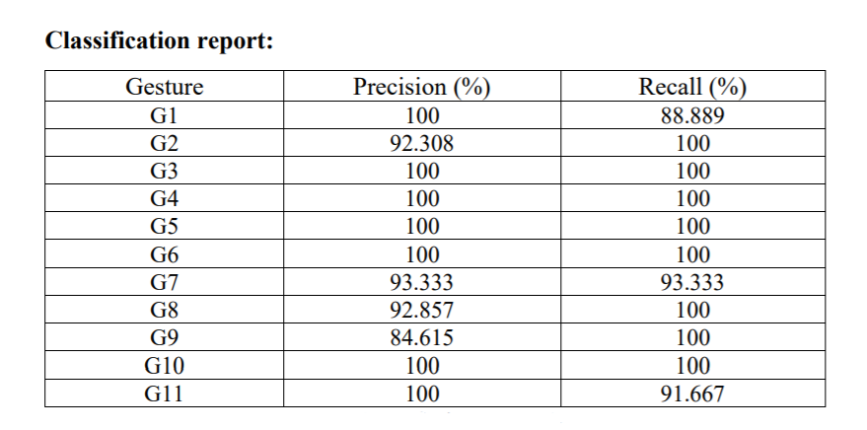
Convolutional Neural Network (CNN)
We used CNNs for feature extraction and multi-class classification.
The layers that were used were:
2D Convolutional Layer
Max Pooling Operation
Densely Connected NN Layer
Flattening Layer
Accuracy achieved through this method:
96.212%

Slide 14
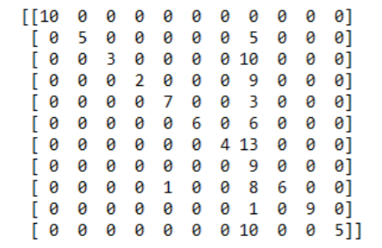
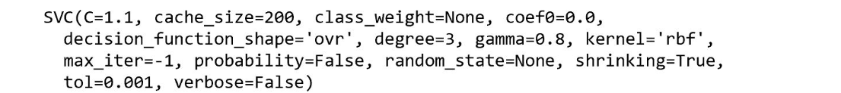
Support Vector Machine (SVM)
The SVM algorithm outputs an optimal hyper plane which categorizes the samples.
The SVC parameters that we used were:
Accuracy achieved through this method:
49.243%
The Confusion Matrix obtained is:

Slide 15
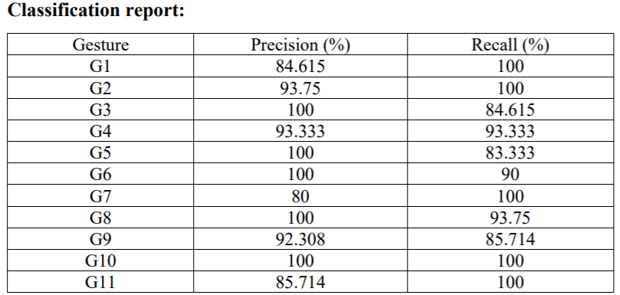
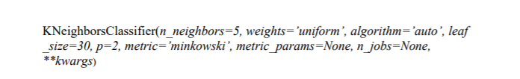
K- Nearest Neighbours (KNN)
K nearest neighbors stores all available cases and classifies new cases based on a similarity of HOG features.
Accuracy achieved through this method:
93.233%

Slide 16
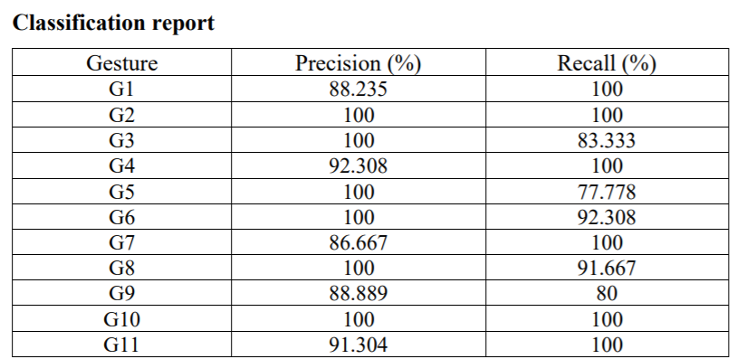
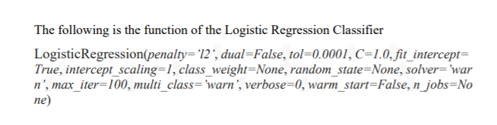
Logistic Regression
Logistic regression was used to learn the relationship between the standardized HOG features and the hand gestures.
Accuracy achieved through this method:
94.108%

Slide 17
Result Analysis

Slide 18
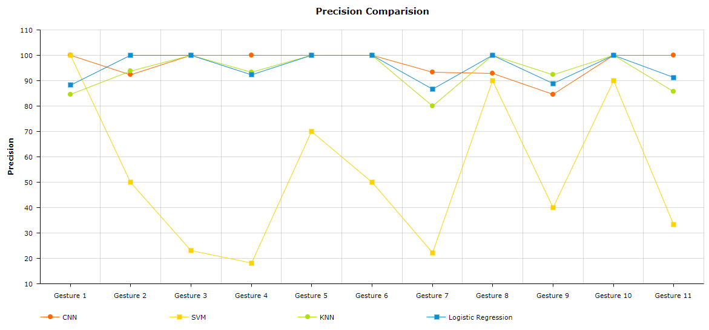
Precision Analysis

Slide 19
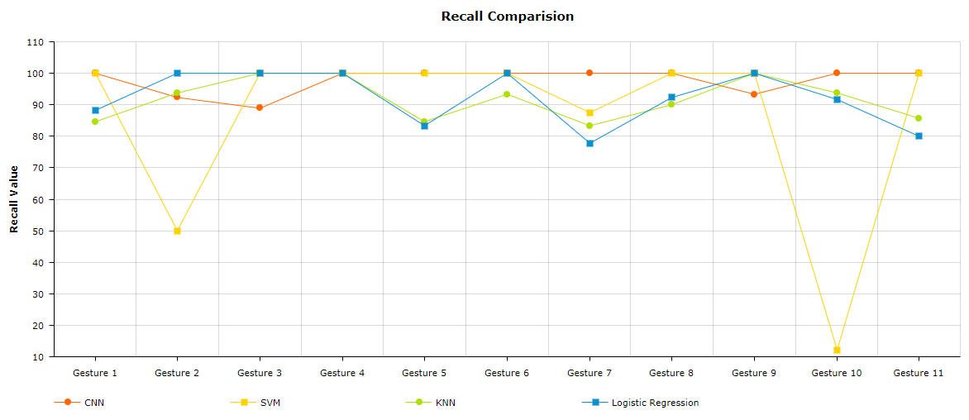
Recall Analysis

Slide 20
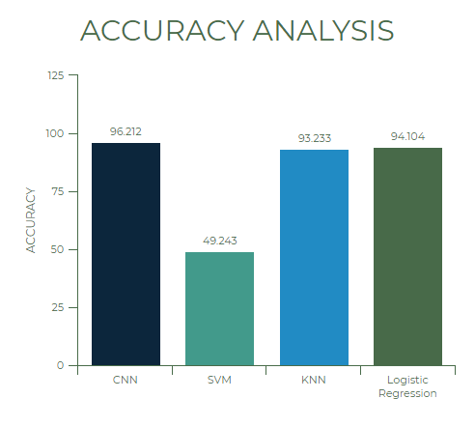
Accuracy Analysis
Therefore, the most accurate and thus the most suitable approach towards Hand Gesture Recognition is through:
Convolutional Neural Networks

Slide 21
Conclusion

Slide 22
Future Scope
Increase quality of feature extraction: Use GLCM along with HOG
Decrease overfitting: Use data augmentation techniques (RGB Jittering, etc.)
Applications
Air Gesture Technologies: Add dynamic image processing and event handling
Sign Language Communicator: Broaden the no. of classification categories.
Remote Control and Robot guidance.
Home Automation Systems.

